Slide 1
OEG-Tools for supporting Ontology Engineering
Daniel Garijo
dgarijo@isi.edu
@dgarijov
Visiting researcher
Idafen Santana-Pérez
isantana@fi.upm.es
@idafensp
Post-doc at OEG
María Poveda-Villalón
mpoveda@fi.upm.es
@MariaPovedaV
Post-doc at OEG
Speakers by lexicographical order
Madrid, 21st July 2016
Notes:
Debliveratively there are no names about the people working in OE in the group.

Slide 2
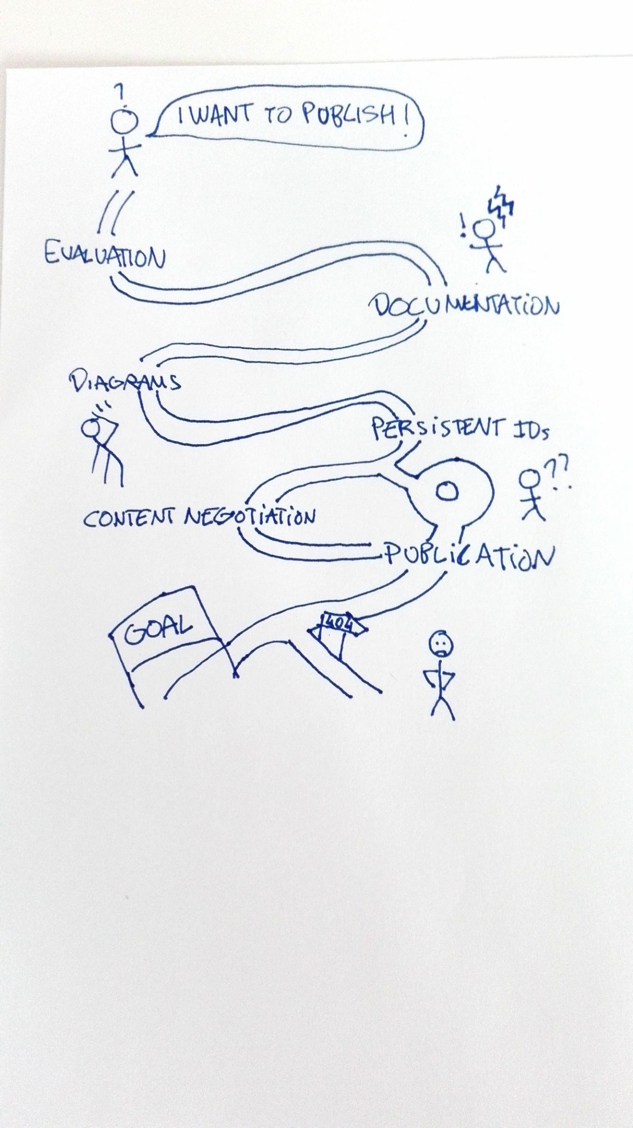

Why?

Slide 3






Tooling landscape
Registration
based on
Publication
integrates
Vocabularium
integrates
integrates
integrates
Documentation
Evaluation

Slide 4
AR2DTool reminder
Registration
Publication
Documentation
Evaluation

Slide 5
OOPS! reminder
Registration
based on
Publication
integrates
Vocabularium
integrates
integrates
integrates
Documentation
Evaluation

Slide 6
vocab.linkeddata.es reminder
Registration
based on
Publication
integrates
Vocabularium
integrates
integrates
integrates
Documentation
Evaluation

Slide 7
Widoco reminder
Registration
based on
Publication
integrates
Vocabularium
integrates
integrates
integrates
Documentation
Evaluation

Slide 8
Table of contents
Registration
1
based on
Publication
integrates
2
3
Vocabularium
integrates
integrates
integrates
Documentation
Evaluation

Slide 9
Table of contents
Registration
1
based on
Publication
integrates
2
3
Vocabularium
integrates
integrates
integrates
Documentation
Evaluation

Slide 10
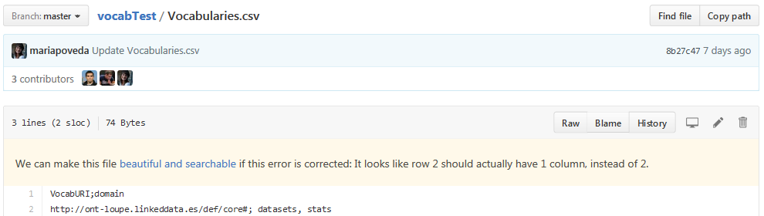
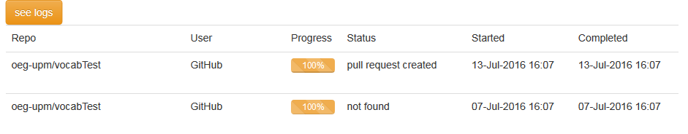
Adding a vocabulary to vocab.linkeddata.es
Go to https://github.com/oeg-upm/vocabTest
Edit Vocabularies.csv file
Add your vocabulary URI and keywords
You can remove the previous entries
Commit changes and wait. You can see your progress here:
http://jarsomatic.linkeddata.es/
You can even do it through the website!

Slide 11
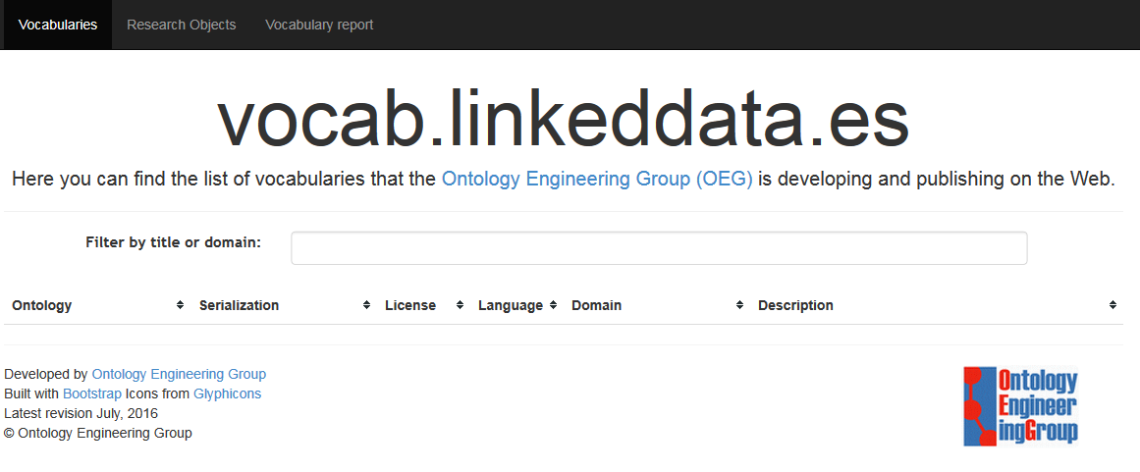
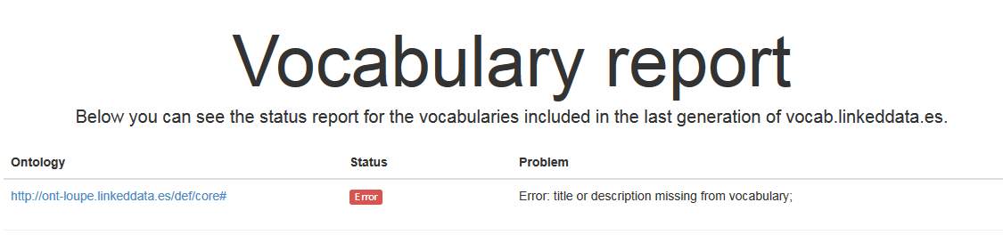
Adding a vocabulary to vocab.linkeddata.es
Once the pull request is created, accept it. Check the results: https://oeg-upm.github.io/vocabTest/site/
Edit your vocabulary and repeat until fix.
No vocabulary has been added, let’s check the report:

Slide 12
Adding a vocabulary to vocab.linkeddata.es
Go to https://github.com/oeg-upm/vocabUpdates/
Edit Vocabularies.csv file
Add your vocabulary URI and keywords
You MUST NOT remove the previous entries
Commit changes and wait. You can see your progress here:
http://jarsomatic.linkeddata.es/. Accept the pull request and contact Raul for re-deployment.
You can even do it through the website!

Slide 13
Table of contents
Registration
1
based on
Publication
integrates
2
3
Vocabularium
integrates
integrates
integrates
Documentation
Evaluation

Slide 14







OnToology
Evaluation reports
HTML documentation
Diagrams
Permanet ids
Content negotiation
Bundle
Previsualization

Slide 15
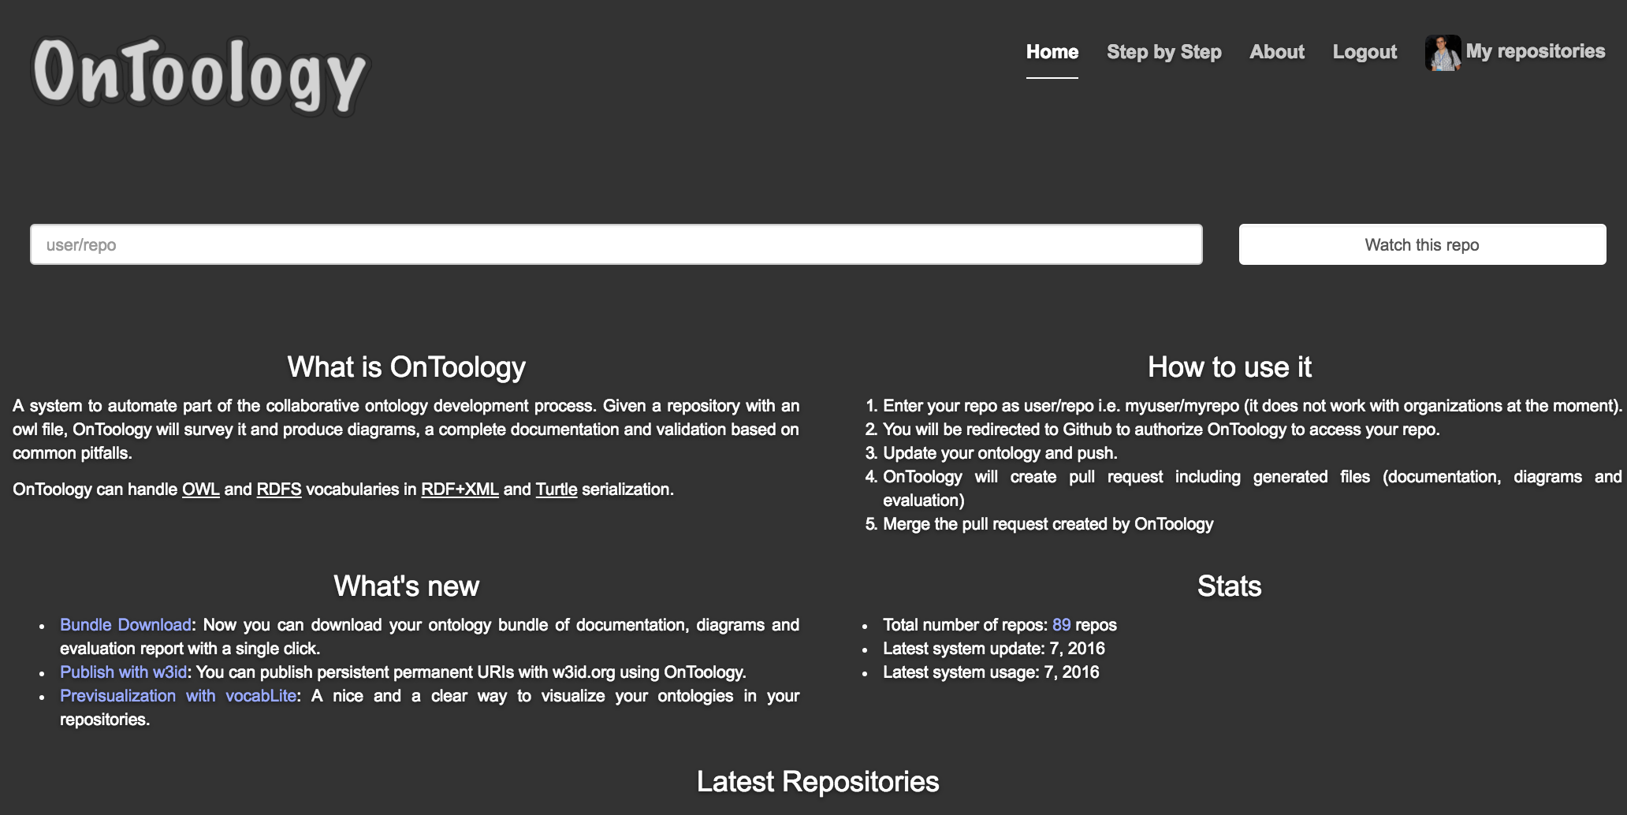
OnToology

Slide 16
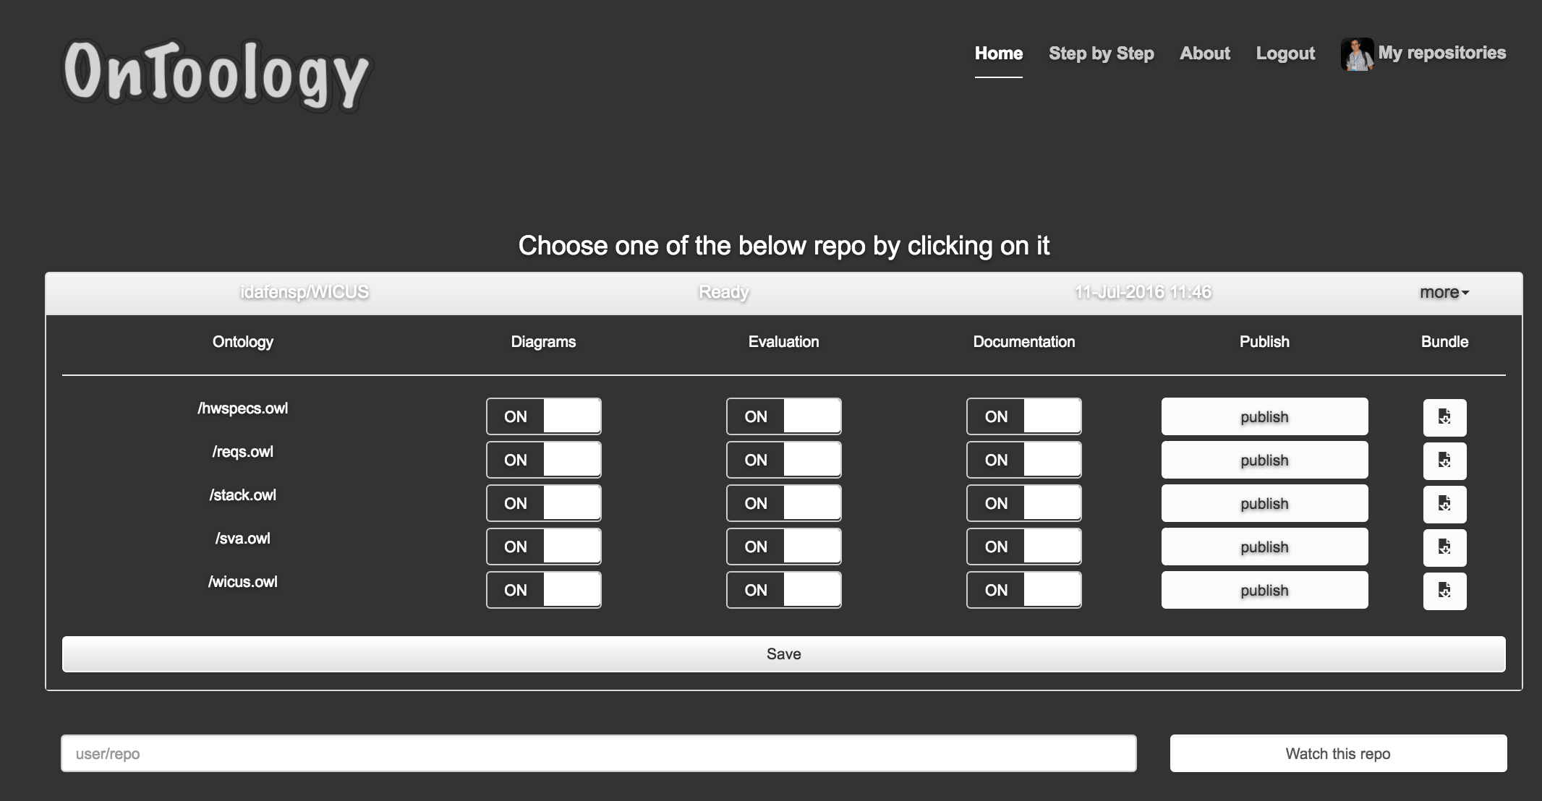
OnToology

Slide 17
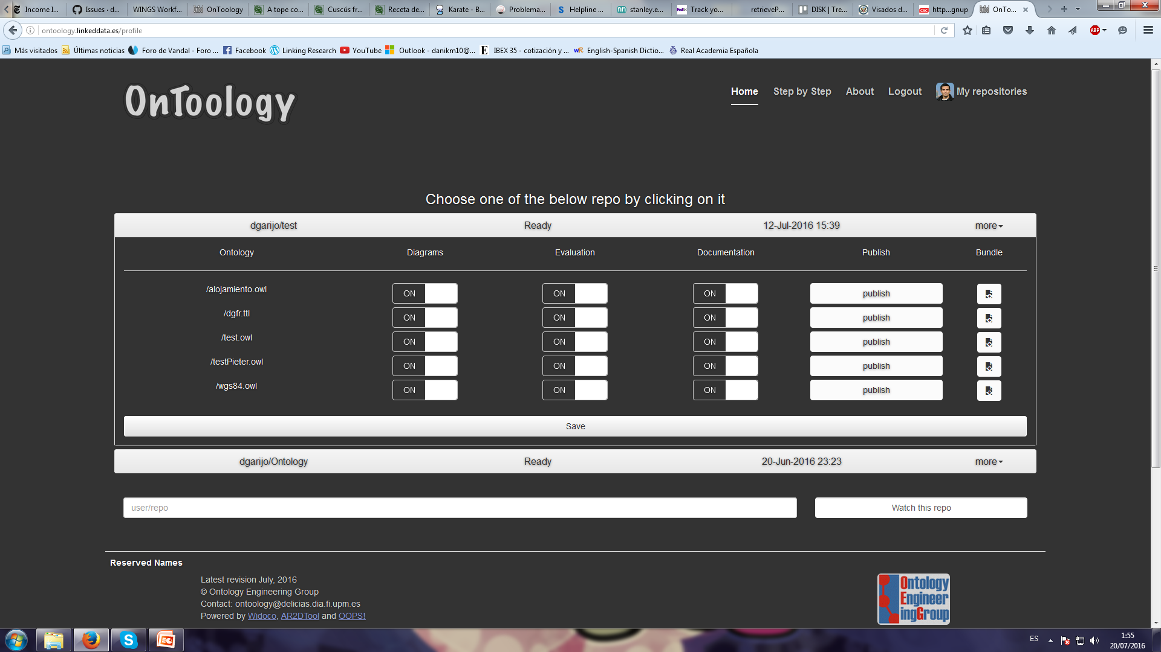
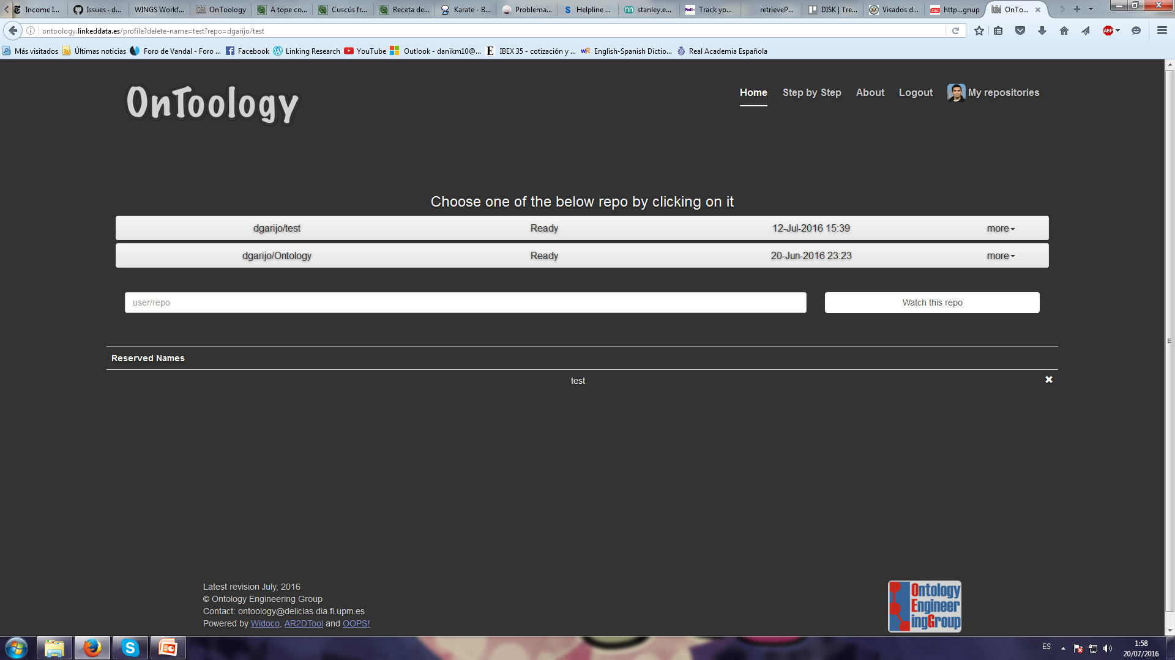
Publishing an ontology with w3id
https://w3id.org/def/test or
https://w3id.org/vocabulary/test
Content negotiation enabled
Can be published within OnToology or in Github

Slide 18
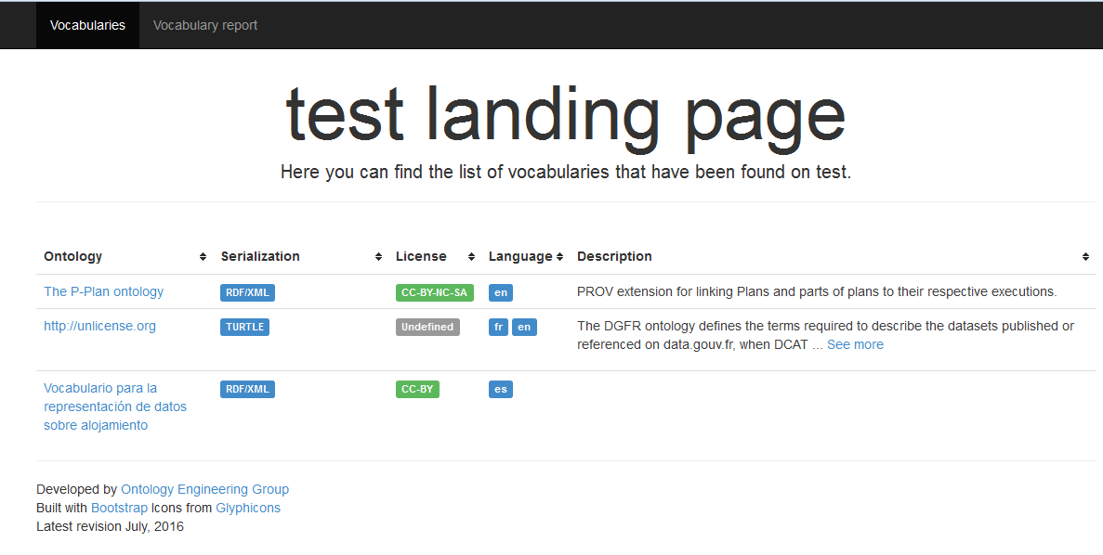
Creating a landing page for a repository
Errors produced in generation
Extracted from ontology metadata
Created by OnToology using VocabLite
Less restrictive than vocab
Helps accessing the contents of a repository

Slide 19
Table of contents
Registration
1
based on
Publication
integrates
2
3
Vocabularium
integrates
integrates
integrates
Documentation
Evaluation

Slide 20
Vocabularium
Vocabularium is an application to serve ontologies online including:
different serializations (RDF/XML, ttl)
HTML documentation
different languages (en, es, etc.)
different versions
Vocabularium does not deal with .htaccess, it implements the content negotiation processing the http accept headers.
https://github.com/SmartDeveloperHub/sdh-vocabulary

Slide 21
Vocabularium
Vocabularium follows a given folder structure for serving the files.
Base URI for all the vocabularies served by an unique instance.
Each instance can serve 1 or more ontologies with the same base URI.
http://mydomain.linkeddata.es/def/ont1
http://mydomain.linkeddata.es/def/ont2
http://onto.mydomain.linkeddata.es/def/
base: http://ont-loupe.linkeddata.es/def/
root: /opt/vocabularium-0.1/loupe/src/ontology
server:
host: 4v.dia.fi.upm.es
port: 8081
docs:
root: /opt/vocabularium-0.1/docs
relativePath: docs
symlink

Slide 22
Future
vocab.linkeddata.es
Automate the publication of the updated site
Form to improve the GitHub workflow
OnToology
Interface
Bug fixing
AR2DTool:
Improve engine
Improve GUI
Widoco
Bug fixing
OOPS!
Extensions
Improve interface
Vocabularium
Issues in GitHub
No support

Slide 23
URLs
vocab.linkeddata.es
URL: http://vocab.linkeddata.es/
GitHub: https://github.com/mariapoveda/vocab.linkeddata.es/
vocabLite
GitHub: https://github.com/dgarijo/vocabLite
OnToology
URL: http://ontoology.linkeddata.es
GitHub: https://github.com/OnToology/OnToology/
AR2DTool
URL: http://ar2dtool.linkeddata.es/
GitHub: https://github.com/idafensp/ar2dtool
Widoco
Github: https://github.com/dgarijo/Widoco/
OOPS!
Web application: http://oops.linkeddata.es/
Web service: http://oops-ws.oeg-upm.net/
Vocabularium
GitHub: https://github.com/SmartDeveloperHub/sdh-vocabulary/tree/feature/publisher

Slide 24
OEG-Tools for supporting Ontology Engineering
Daniel Garijo
dgarijo@isi.edu
@dgarijov
Visiting researcher
Idafen Santana-Pérez
isantana@fi.upm.es
@idafensp
Post-doc at OEG
María Poveda-Villalón
mpoveda@fi.upm.es
@MariaPovedaV
Post-doc at OEG
Speakers by lexicographical order
Madrid, 21st July 2016
Notes:
Debliveratively there are no names about the people working in OE in the group.

